Slide 1
WORLD OF TECHNOLOGY
Unit 0 – Section 1 – Day 1

Slide 2
THE BIG IDEA
The 21st century skills of collaboration and problem solving are essential for engineering solutions of the future.

Slide 3
THE ASSIGNMENT
Design a self-propelled vehicle that will transport a passenger safely from point A to Point B.
Restrictions:
  You may only use the provided materials
  You have one class period to complete the activity

Slide 4
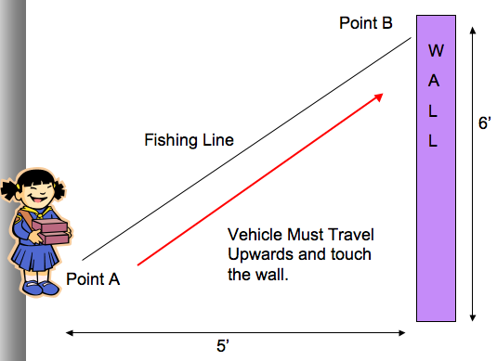
THE COURSE

Slide 5
THE MATERIALS
You must construct a vehicle to travel from point A to point B under its own power using only the following materials:
  12” of Masking tape
  1 Popsicle Stick
  1 Balloon
  2 paper clips
  2 rubber bands
  1 Clothespin for a passenger

Slide 6
THE GUIDELINES
You can only use the materials provided.
It must travel along a fishing line in an upward direction from point A to point B.
You cannot assist the vehicle in traveling up the string.
The passenger must arrive safely without falling off the vehicle.
The vehicle must remain in one piece.
The vehicle must remain on the string after reaching point B.

